Slide 1
Input and Output
6
Chapter 6

Slide 2
Learning Outcomes
Define input.
Describe keyboard entry including types and features of keyboards.
Identify different pointing devices including game controllers and styluses.
Describe scanning devices including optical scanners, RFID readers and recognition devices.
Recognize image capturing devices and audio-input devices.
Define output.
Identify different monitor features and types including flat-panels and e-books.
Define printing features and types including inkjet and cloud printers.
Recognize different audio and video devices including portable media devices.
Define combination input and output devices including multifunctional devices, telephones, drones, robots, and VR headgear and gloves.
Explain ergonomics and ways to minimize physical damage.

Slide 3

Introduction
Have you ever wondered how information gets into your computer or comes out in a form you can use?
Input devices convert what we understand into what the system unit can process
Output devices convert what the system unit has processed into a form that we can understand

Slide 4
What is Input?
Any data or instructions used by a computer
Input devices translate data into a form that the system unit can process
Some hardware input devices include:
Keyboards
Mice
Pointing
Scanning
Image capturing
Audio-input
Notes:
Input (key term)
Input devices (key term) are hardware used to translate words, sounds, images, and actions that people understand into a form that the computer can understand
Input allows user to put their information into computer language
Most common are keyboard, mouse, scanning devices, image capturing devices and audio-input devices

Slide 5
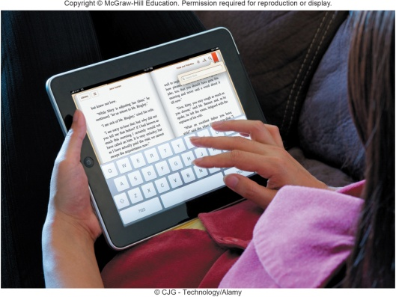
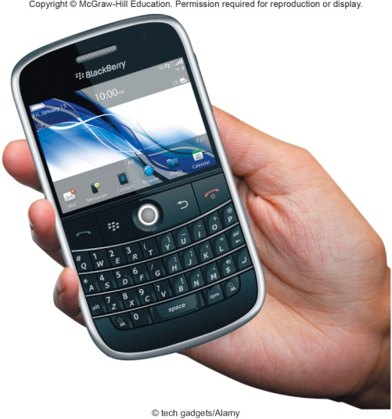
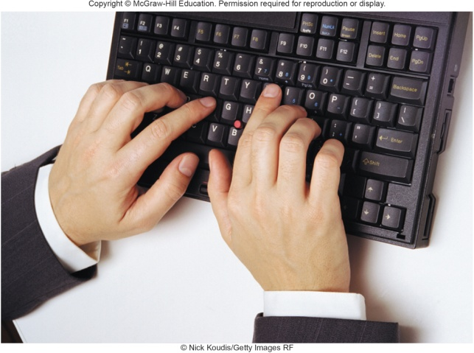
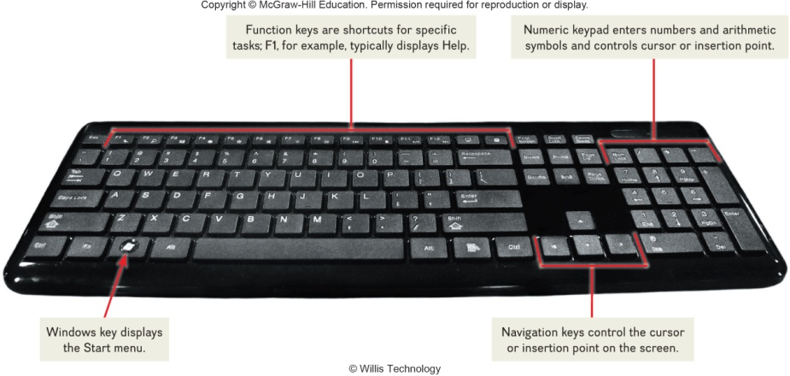
Keyboard Entry
Keyboards
Traditional keyboards
Laptop keyboards
Virtual keyboards
Thumb keyboards
Notes:
Keyboards (key term) come in a variety of designs – most common way to input data
Range from full-sized to miniature and from rigid to flexible
Common types
Traditional keyboard (key term) – full sized, rigid, rectangular keyboards that include function, navigational, and numeric keys
Laptop keyboard (key term) – used on laptop computers
Virtual keyboard (key term) – keyboard for a tablet PC and mobile devices– shown on a touch screen
Thumb keyboard (key term) – used on smartphones

Slide 6
Pointing Devices
Provide an intuitive interface by accepting pointing gestures and converting them into machine-readable input
Wide variety of devices such as:
Mouse
Touch screen
Game controller
Stylus
Notes:
Pointing Devices (key term) provide an intuitive interface by accepting pointing gestures and converting them into machine-readable input

Slide 7
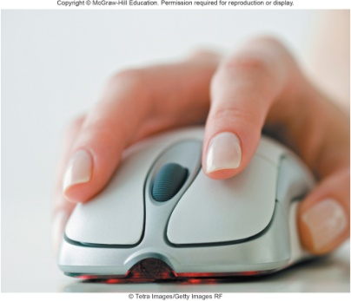
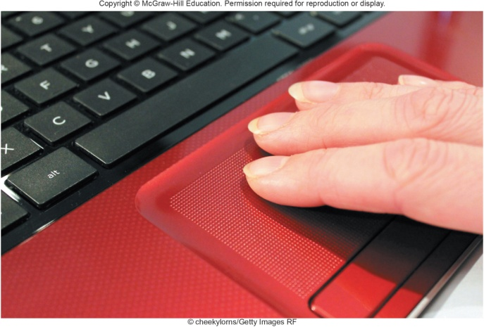
Mouse Types
Optical mouse
Has no moving parts
Emits and senses light to detect mouse movement
Can be used on any surface
Wireless mouse
Battery operated
Uses radio waves or infrared light waves
Touch pads
Controls pointer by moving and tapping your fingers on the surface of the pad
Notes:
Mouse (key term) controls a mouse pointer (key term) that appears in the shape of an arrow
Some mice have a wheel button (key term) for scrolling. The Optical Mouse (key term) is the most widely used
Mouse types
Optical mouse (Key Term) – has no moving parts
Emits and senses light to detect mouse movement
Can be used on any surface
Cordless mouse (Key Term) or wireless mouse (Key Term) – battery powered
Uses radio waves or infrared light waves
Touch pads (key term) –controls the pointer by moving and tapping your fingers on the surface of a pad

Slide 8
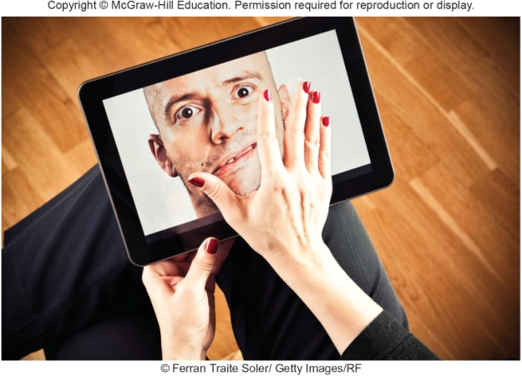
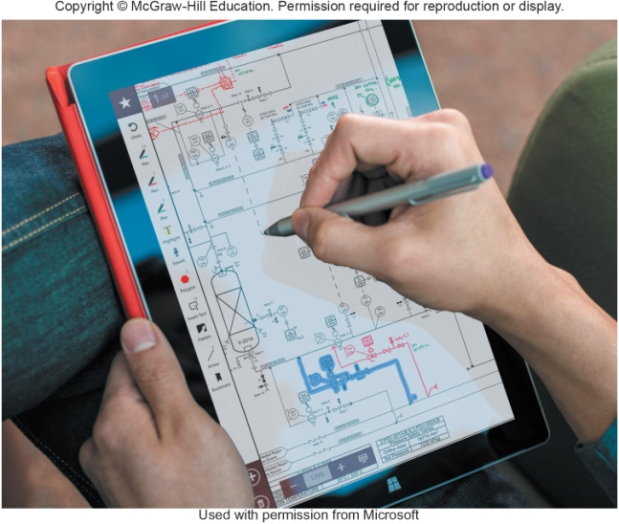
Touch Screen
Can be touched with more than one finger
Common on mobile devices
Apple iPhone
Notebook computers
Desktop monitors
Stylus is a pen-like device
Used on tablets
Uses handwriting recognition software
Notes:
Multitouch screen (key term) – can be touched with more than one finger, which allows for interactions such as rotating graphical objects on the screen with your hand or zooming in and out by pinching and stretching your fingers. These screens are common on mobile devices such as the Apple iPhone, and some notebook computers and desktop monitors.
Stylus works using handwriting recognition software. It is a pen-like device.

Slide 9
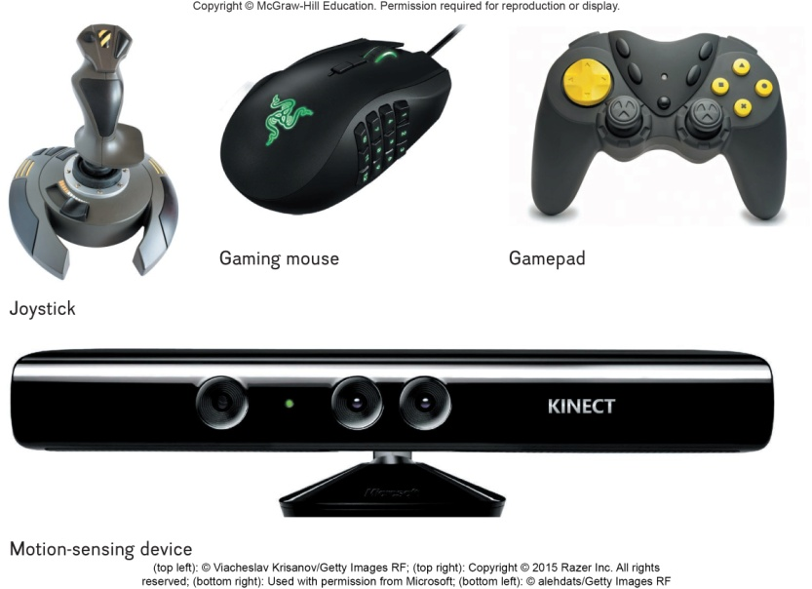
Gaming Controllers
Provide input to computer games
Joysticks use pressure and direction of the stick
Gaming mice are similar to a mouse but high precision
Game pads use both hands
Motion sensing device control games by user movement
Notes:
Joystick (key term)– control game actions by varying pressure, speed and direction
Gaming Mouse – similar to traditional mice with higher precision, faster responsiveness, programmable buttons, and better ergonomics
Game pads (key term) – held by two hands
Motion sensing device (key term) – control games by user movement

Slide 10
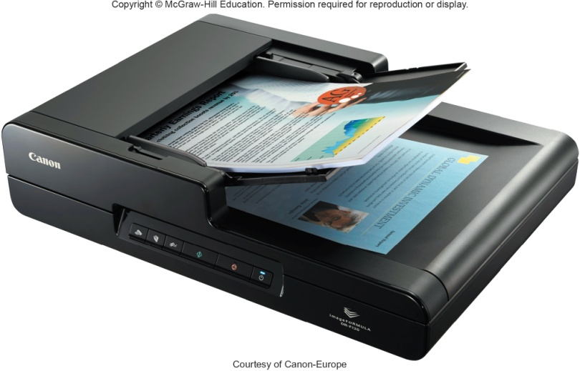
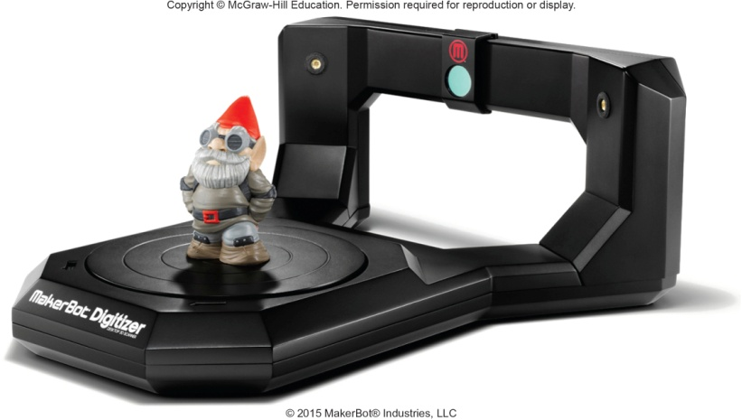
Scanning Devices
Scanners convert scanned data into a form the system unit can process
Optical scanners
Flatbed scanners
Document scanners
Portable scanners
3D scanners
Notes:
Scanning devices (key term) convert scanned data into a form the system unit can process
Types
Optical (key term) – known as a scanner (key term)
Recognizes light, dark, and colored areas that make up individual letters or images
Types
Flatbed (key term)– much like a copy machine
Document (key term)– similar to flatbed except that it can quickly scan multipage documents; automatically feeds one page of a document at a time
Portable (key term)– typically a handheld device that slides across the image making direct contact
3D (key term) – uses lasers, cameras, or robotic arms to record the shape of an object

Slide 11
Card Readers
Interpret encoded information that is stored on debit, credit and identification cards
Magnetic card reader
Information read from strip when swiped through reader
Smart cards hold additional security information
Notes:
Card Readers (key term) interpret encoded information that is stored on debit, credit, and identification cards
Types
Magnetic card reader (Key Term) – information is stored on a thin magnetic strip on the back of a card; is read when swiped through a card reader

Slide 12
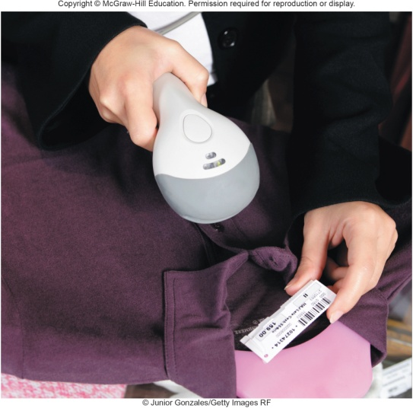
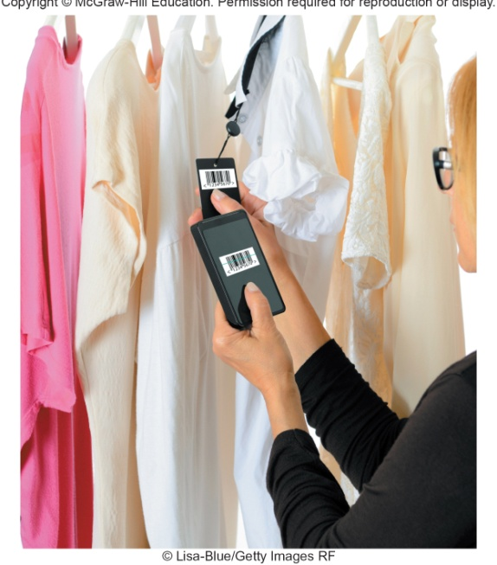
Bar Code Readers
Contain photo-electric cells that scan or read bar codes or the zebra striped marks printed on product containers
Wand readers
Hand –held readers
UPCs and MaxiCode readers
UPC are heavily used in grocery stores for automated checkout and inventory control
MaxiCode used by shipping companies for routing packages
Notes:
Bar code readers or bar code scanners (Key Term)
You see these devices at the grocery store
Wand reader (key term) or platform scanner (key term)
Reads bar codes or vertical zebra striped marks printed on product containers
Products have a UPC (Universal Product Code) (Key Term)
MaxiCode (key term) used for routing and tracing packages

Slide 13
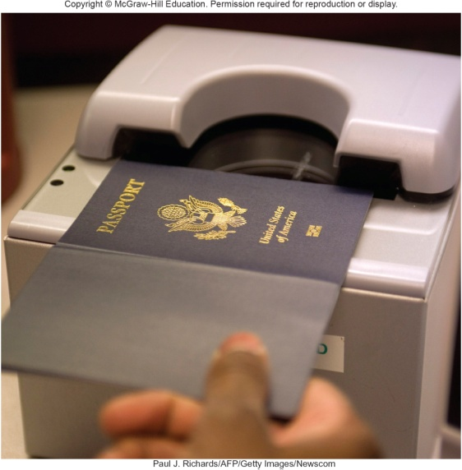
RFID Readers
Radio-frequency identification
Tiny chips embedded in most anything contain electronically stored information that can be read using an RFID reader located several yards away.
Tracking pets
Update and control inventories
Read passports
Notes:
RFID (radio frequency identification) tags are tiny chips embedded for tracking in most anything.
They contain electronically stored information that can be read using an RFID readers
Read by RFID readers (key term)

Slide 14
Character and Mark Recognition Readers
Recognize special characters and markts
Character and mark recognition devices
Magnetic-ink character recognition (MICR)
Used by banks to read encoded characters on checks
Optical-character recognition (OCR)
Reads preprinted characters such as wand scanners
Optical-mark recognition (OMR)
Sense the presence of absence of marks used for test scoring
Notes:
Character and mark recognition devices are scanners that recognize special characters & marks
MICR (key term)– used by banks to read magnetically encoded characters on the bottom of checks and deposit slips; numbers are read by a reader/sorter
OCR (key term)– specially preprinted characters are read by OCR devices such as wand scanners, read price tags
OMR (key term) (also called mark sensing) – devices sense the presence or absence of marks, common for standardized and multiple choice test scoring

Slide 15
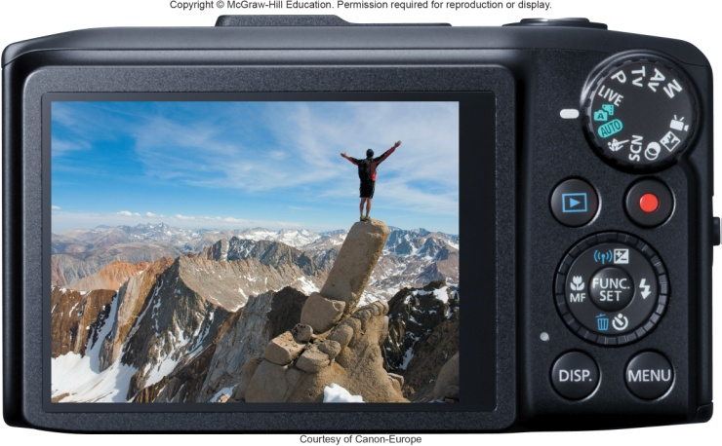
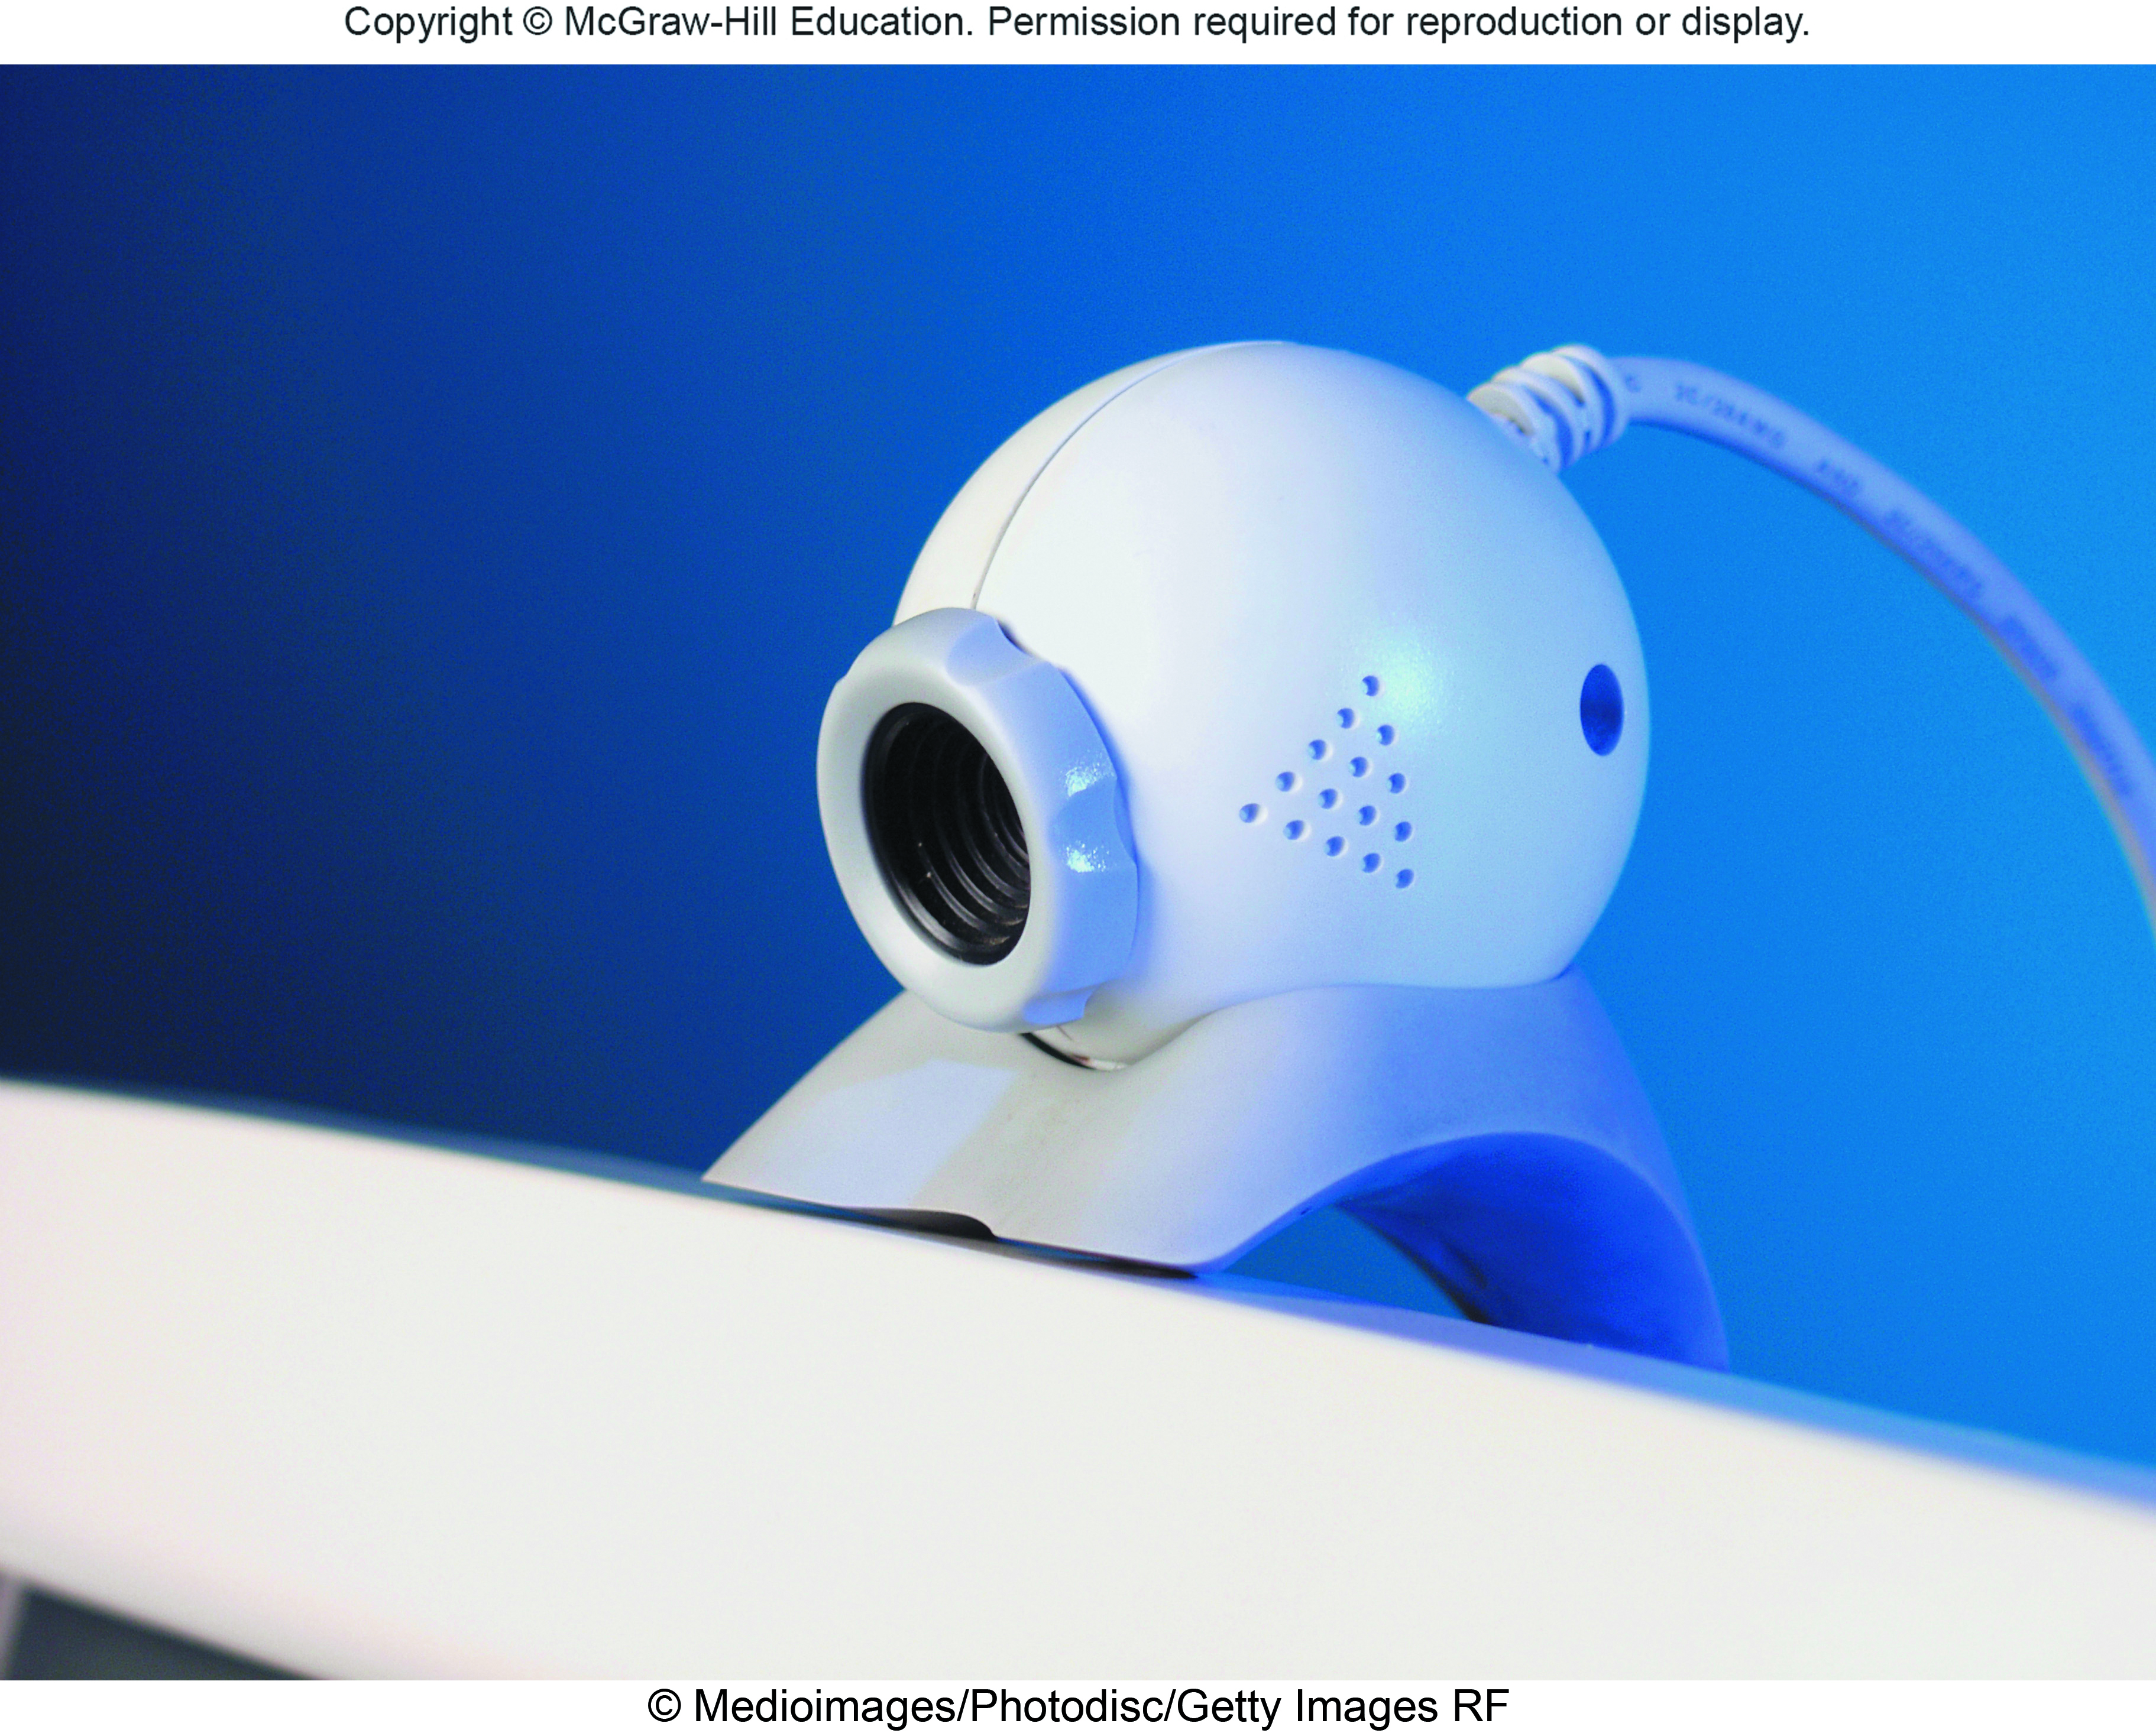
Image Capturing Devices
Create or capture original images
Digital Camera
Capture images digitally and store in memory
Web Cams
Capture images and send to a computer
Notes:
Imaging capturing devices create or capture original images
Digital cameras (key term) – similar to traditional cameras except images are recorded digitally on disk or a camera’s memory
Webcams (key term) – also referred to as web cameras are specialized digital video cameras that capture images and send them to a computer to broadcast over the Internet
Built into smartphones and tablets

Slide 16
Audio-Input Devices
Voice recognition systems
Use a microphone, sound card, and special software
Users can operate computers and create documents using voice commands
Included in many smart phones
Siri in iPhones
Cortana in Windows phones
Google Now in Google phones
Notes:
Audio output devices convert sound into a form that can be processed by the system unit
Microphone is the most popular device
Voice recognition systems (key term)
Microphone, bundled with sound card and software
Some can translate from one language to another
Comes as a standard in smart phones

Slide 17
Output
Processed data or information
Types of output
Text
Graphics/photos
Audio & video
Output devices
Monitors
Printers
Audio-output devices
Notes:
Output (key term) is process data or information
Converts machine-readable information into people-readable form
Most common output types – text, graphics, photos, audio, and video
Output device is any hardware used to provide or to create output
The most widely used output devices (key term) are monitors, printer, and audio-output devices

Slide 18
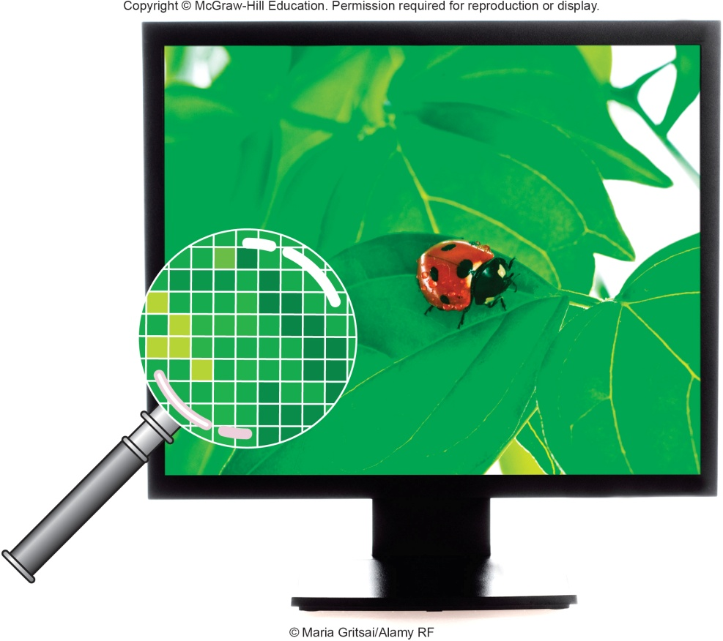
Monitors
Known as screens or display screens and present visual images of text and graphics
Output referred to as soft copy
Features
Clarity
Resolution/pixels
Dot pitch
Contrast ratios
Size
Aspect ratio
Notes:
Monitors are commonly called display screens (Key Term) and the output is referred to as soft copy (key term)
Standards indicate screen quality (resolution). Some monitors are used on the desktop, others are portable.
Features – most important is clarity (Key Term)
Clarity (key term) – quality and sharpness of the displayed images
Resolution (key term) – one of the most important features; images are formed on a monitor by a series of dots or pixels (picture elements) (Key Term)
Dot (pixel) pitch (Key Term) – the distance between each pixel; most newer monitors have a dot pitch of .30 mm (30/100th of a millimeter) or less
Contrast ratios (key term) – monitor’s ability to display color
Size (key term) – or active display area is measured by the diagonal length of a monitor’s viewing area
Common sizes are 15, 17, 19, 21, and 24 inches
Aspect ratio (key term)– determined by the width of a monitor divided by its height. Common aspect ratios for monitors are 4:3 (standard) and 16:10 (wide screen).

Slide 19
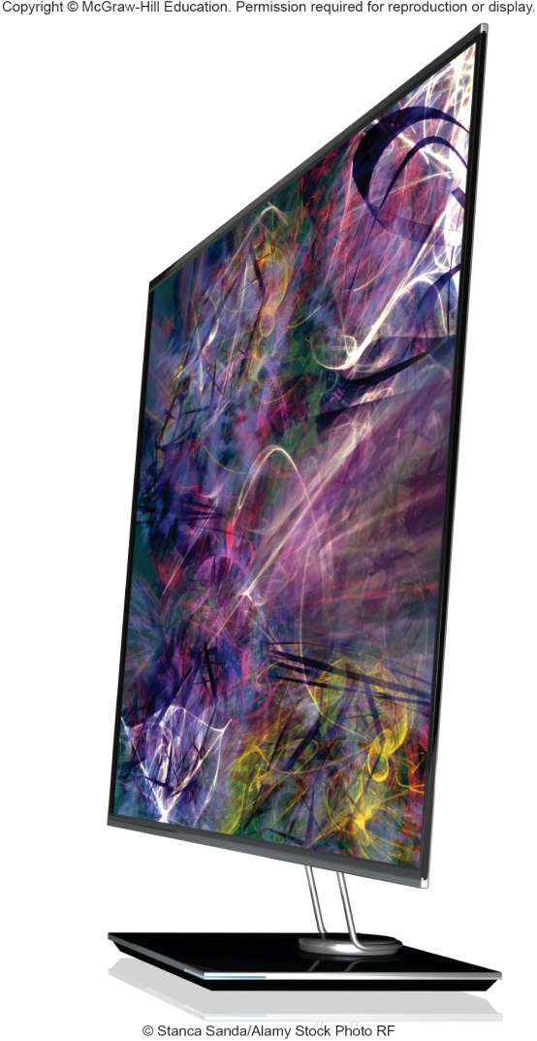
Monitor Types
Flat-panel monitors
Require less power to operate
Portable and thin
Most are backlit
Three types:
Liquid Crystal Display (LCD)
Older monitors
Light Emitting Diode (LED)
More advanced backlighting
Organic Light Emitting Diode (OLED)
Thin layer organic compound that produces light
Notes:
Flat-Panel Monitors (key term) – are most widely used.
Require less power to operate
Portable and thin
Most are backlit

Slide 20
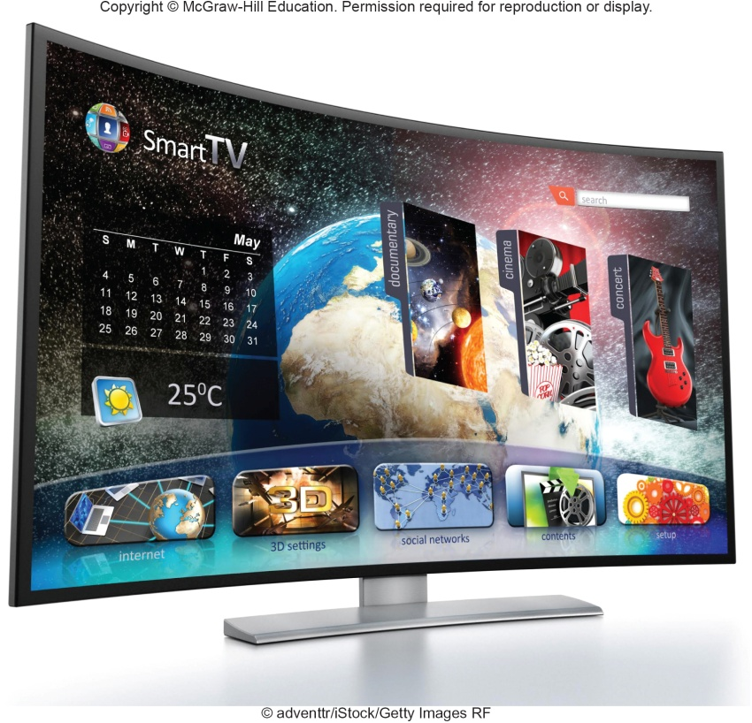
Curved Monitors
Has a concave screen that provides better viewing angles near the edges of the screen
Used by high-end gamers
Used for smart watch displays
Notes:
The curved monitor is the newest development in monitors.
Uses a concave screen to provide better viewing
Used by high-end gamers and the technology is used for smart watch displays

Slide 21
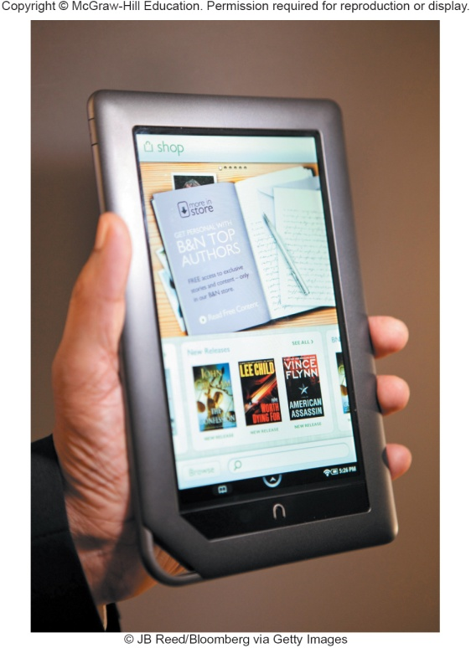
E-book Readers
An e-book is a traditional books printed in electronic form
E-book readers are dedicated mobile devices for storing and displaying e-books
Use e-ink technology
Produce images that reflect light
Kindle
Nook
Notes:
E-books (key term) are traditional books printed in electronic form
E-books are read using an e-book reader (key term)
E-book readers are dedicated mobile devices for storing and displaying e-books.
Use e-ink (key term) technology that produces images that reflect light
Amazon Kindle
Barnes and Noble Nook

Slide 22
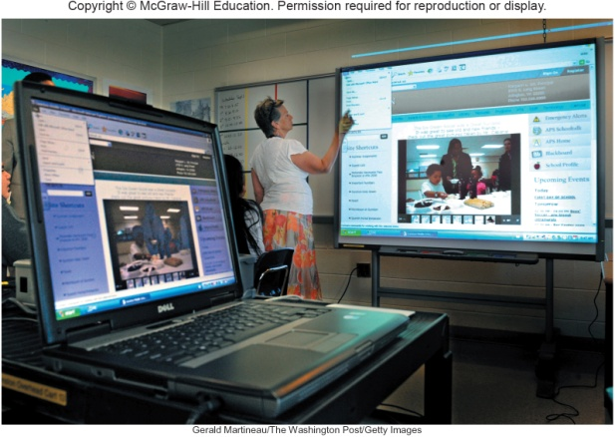
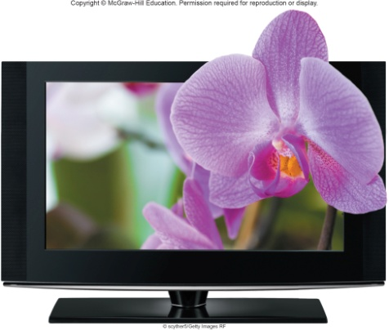
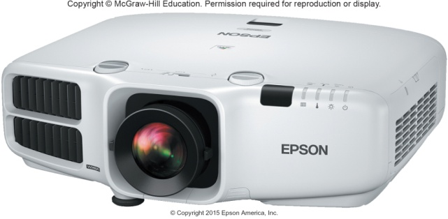
Other Monitor Types
Other monitors
Digital/interactive whiteboards
Connects to a computer or project
Controlled using a special pen or even your finger
Classrooms and corporate boardrooms
Ultra High-definition television (UHDTV)
Digital output delivering a much clearer and more detailed image that regular HDTV
Digital Projector
Project the images from a traditional monitor onto a screen or wall
Notes:
Digital whiteboards – specialized devices with a large display connected to a computer or projector. The computer’s desktop is displayed on the digital whiteboard and controlled using a special pen, a finger, or some other type of device. Digital whiteboards are used in classrooms and corporate boardrooms.
UHDTV ultra high-definition television (UHDTV)– delivers a much clearer and more detailed wide-screen picture than regular HDTV. Because the output is digital it makes it easier to edit. This technology is very useful to graphic artists, designers, and publishers.
Digital projector (Key term) projects the images from a traditional monitor onto a screen or wall

Slide 23
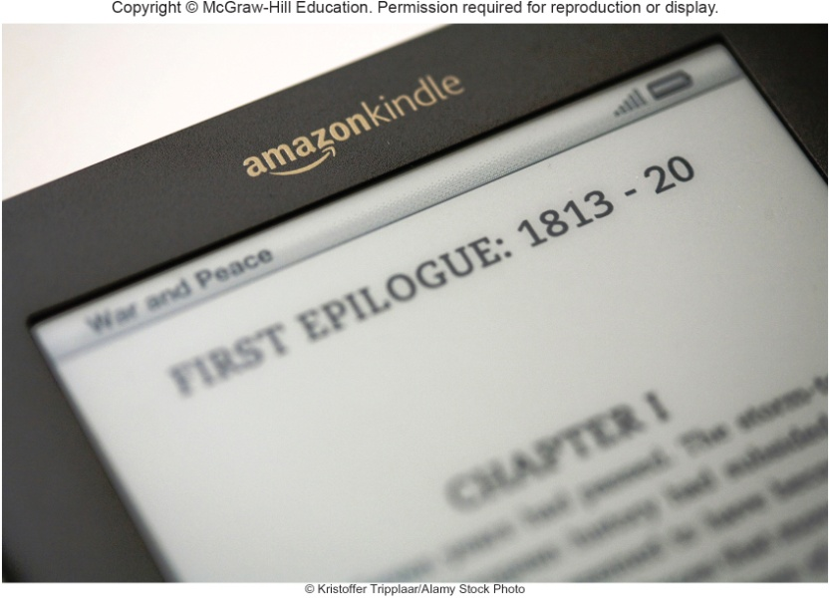
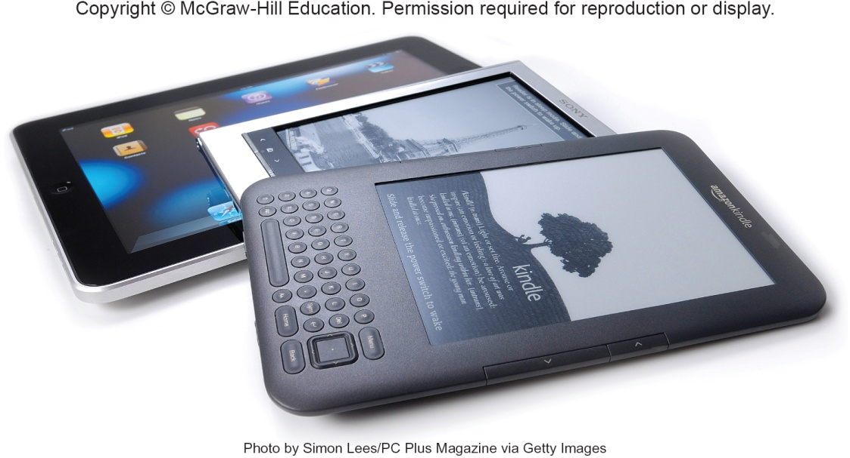
Making IT Work for You ~ Using E-Books
Enjoy reading on the go
Many feature subscriptions to newspapers and magazines

Slide 24
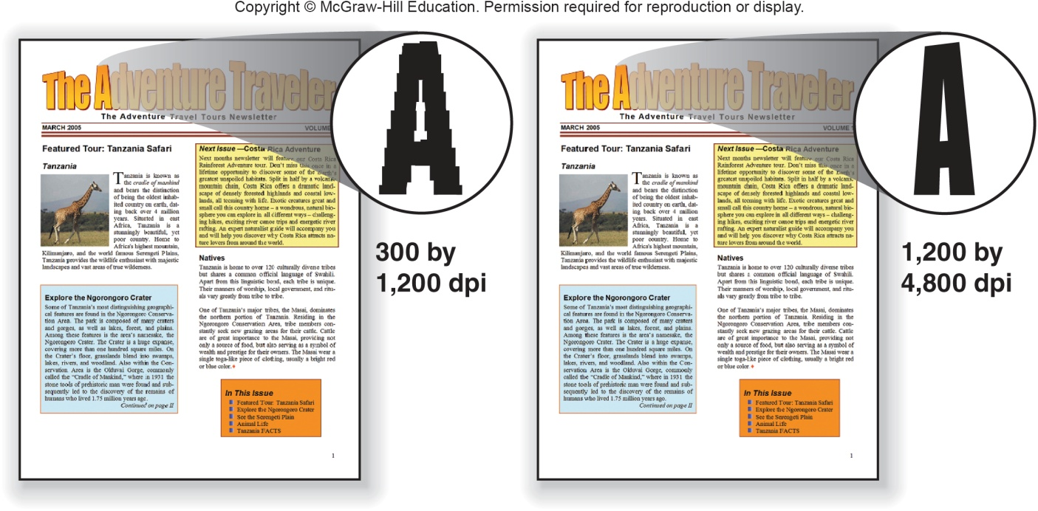
Printers
Translates information that has been processed by the system unit
Output referred to as hard copy
Features
Resolution
Color
Speed
Memory
Duplex printing
Notes:
Printers (key term) translate information that has been processed by the system unit and present the information on paper
Output is called hard copy
Features
Resolution (key term) – measures the clarity of images produced
Measured in dots-per-inch (dpi) (Key Term)
Most printers use an average of 1200 dpi x 4800 dpi; the higher the dpi, the better the quality of image produced
Color (key term) – more expensive to print in color; usually have the option to print in either color or b/w. Grayscale (key term) images are displayed using shades of gray.
Speed (key term) – measured in the number of pages printed per minute
15-19 pages per minute is the average for a single color page (black); 13-15 pages per minute for color
Memory (key term) – used to store printing instructions and documents waiting to be printed
Duplex printing (key term) – automatic printing on both sides of a sheet of paper

Slide 25
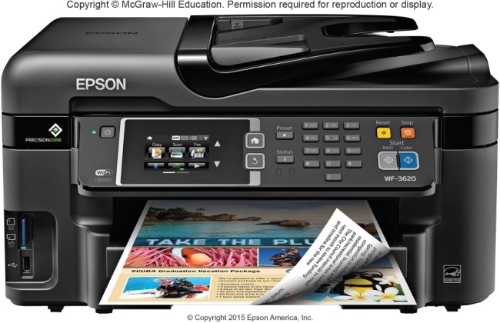
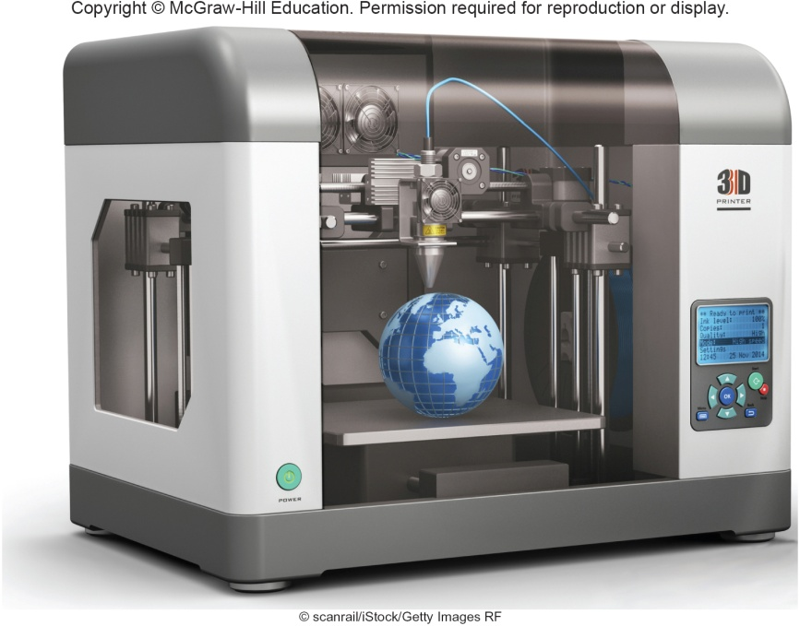
Printer Types
Ink-jet printers spray ink at a high speed
Reliable, quite and inexpensive
Laser printers uses a laser light beam to produce images
Fast, excellent quality
Personal or shared
3D Printers create 3-D shapes with a thin layer of material repeatedly until created
Additive manufacturing
Notes:
Inkjet printers (key term) spray ink at high speed onto the surface of paper
Reliable, quiet and inexpensive
Laser printers (key term) uses a laser light beam to produce images
Faster, excellent quality and more expensive than ink jet printers
Personal (key term) and shared (key term) laser printers
3D Printers (key term)
Creates 3-dimensional shapes, adds a thin layer of material repeatedly until the item is created

Slide 26
Other Printers
Cloud printers
Connected to the Internet to provide services to others on the Internet
Thermal printers
Plotters
Notes:
Other Printers
Cloud (key term) – connected to the Internet and provide printing services to others on the Internet. Google Cloud Print is an example. Once a user activates a printers using Google Chrome OS, the user can access the printer anywhere with an Internet connection.
Thermal printers (key term) – uses heat elements to produce images on heat sensitive paper, ATMs and gas pumps
Plotters (key term) – special purpose for maps, images, architectural & engineering drawings

Slide 27
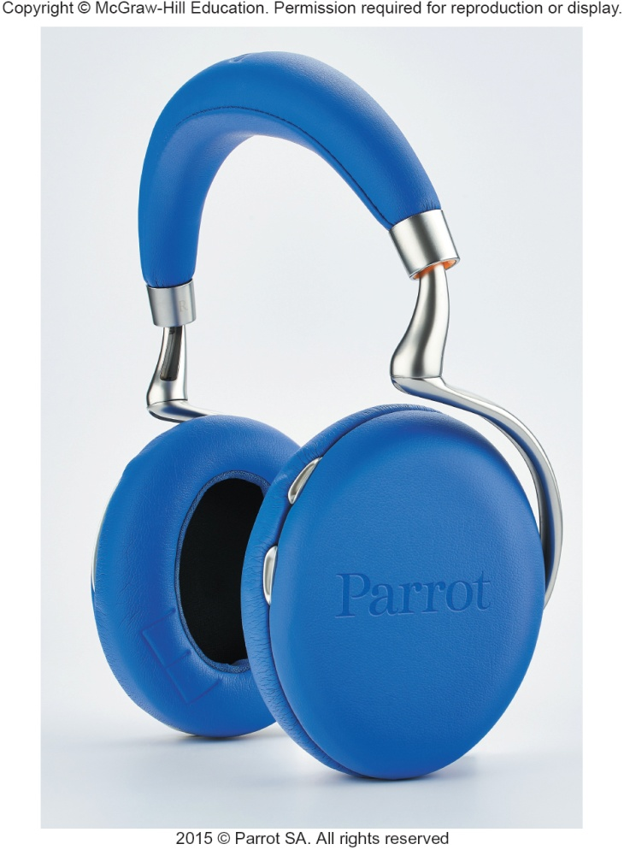
Audio and Video Devices
Translates audio information from the computer into sounds that people can understand
Speakers and headphones
Bluetooth Technology
Wireless technology
Used to connect to speakers and headsets
Notes:
Speakers (key term) and headsets (key term) are the most widely used audio-output devices
Connected to a sound card in the system unit
Voice output is quite common; creating voice output is not as difficult as recognizing and interpreting voice input
Bluetooth (key term) technology – wireless technology used to connect speakers and headsets to wireless sound cards

Slide 28
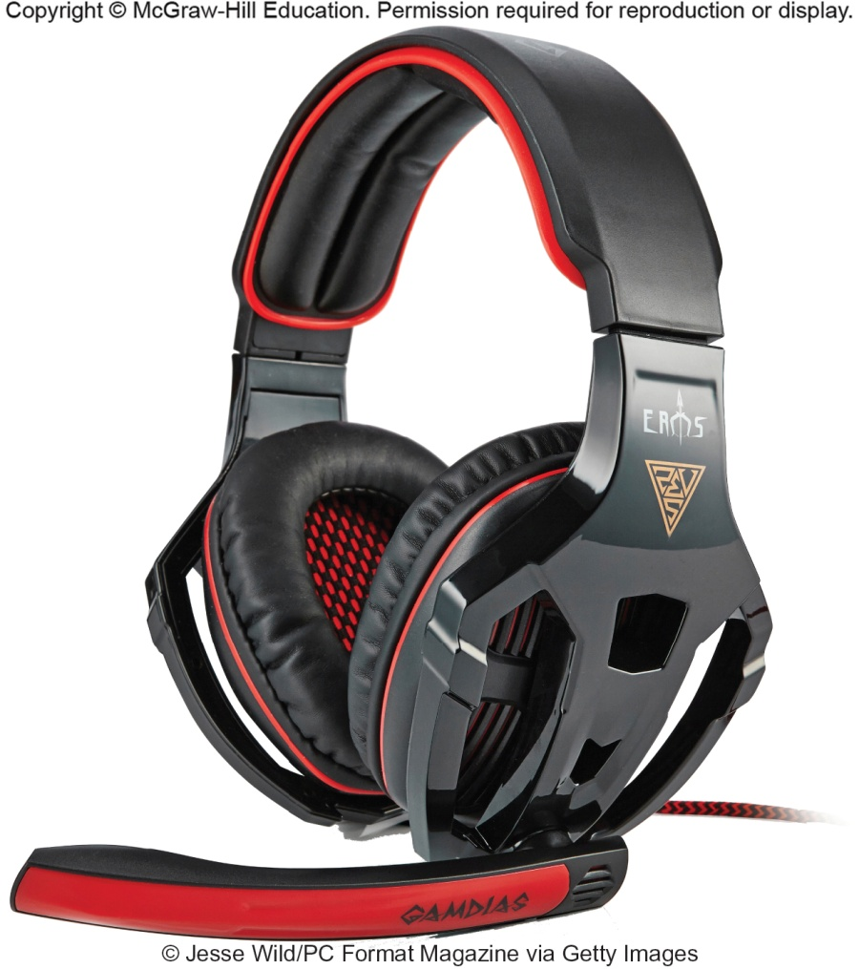
Combination Input and Output Devices
Headsets
Combine a microphone and headphones
Multifunctional devices (MFD)
Cost efficient but lower quality
All-in-one printers are a good example
Telephones
Known as Telephony and Internet Telephony
Voice-over IP (VoIP)
Hangouts
Face Time
Skype
Notes:
Multifunctional devices (MFD) (key term) combine the capabilities of a scanner, printer, fax and copy machine
Usually lower in price and more cost efficient than purchasing the products separately; however the quality is lower
Telephone (key term) – specialized input and output devices for receiving and sending voice communication
Voice over IP (VoIP) (Key Term) – voice and other types of communication over the Internet
Also known as telephony (key term) and Internet telephony (key term) - VoIP application that uses VoIP
Providers include Hangouts, FaceTime, and Skype
Skype – doesn’t need any special hardware. Once you subscribe use your computer’s existing audio and video to communicate with any other Skype subscribers. Skype is free for domestic calls and low-cost for international. For an additional fee you can place calls to non-Skype subscribers.

Slide 29
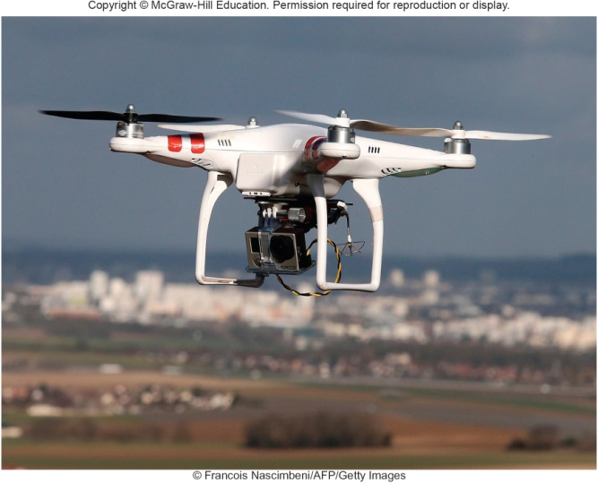
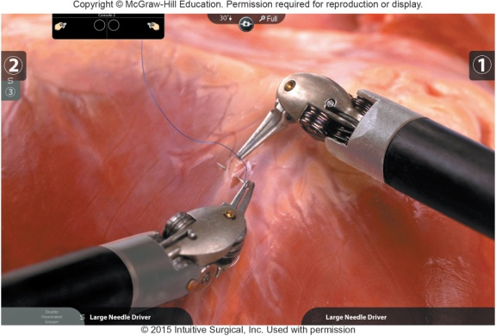
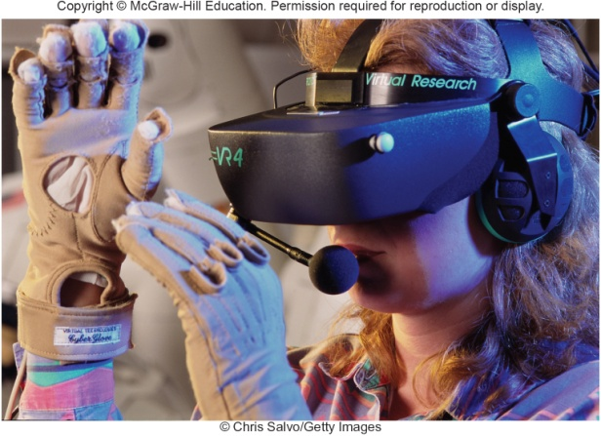
Drones and Robots
Drones or unarmed aerial vehicles
Take input from a controller and send back video and sound to the user
Very cost effective now
Robots
Use microphones, cameras and other sensors as input
Output is dependent on the use for the robot
Assists in surgery
Virtual Reality
Created in 3D through computers for a virtual experience
Headgear with gloves have sensors to collect data that work with software
Notes:
Drones or unarmed aerial vehicles take input from a controller and send video and sound back to the user.
They are now more cost effective
Robots use microphones, cameras and other sensors as input. The output is dependent on the use for the robot.
Robots even assist in surgery
Virtual Reality (key term) – simulated reality created in 3-d through computers. Creates a virtual or (immersive experience)
Headgear (key term) and gloves (key term) have sensors to collect data that work with software

Slide 30
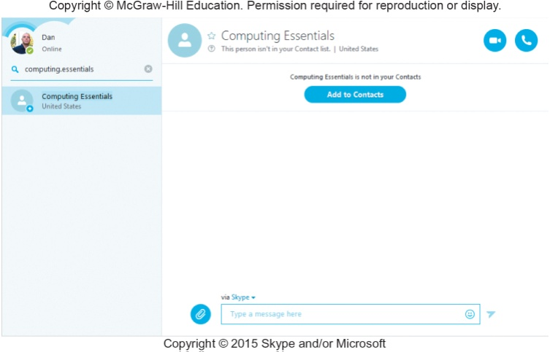
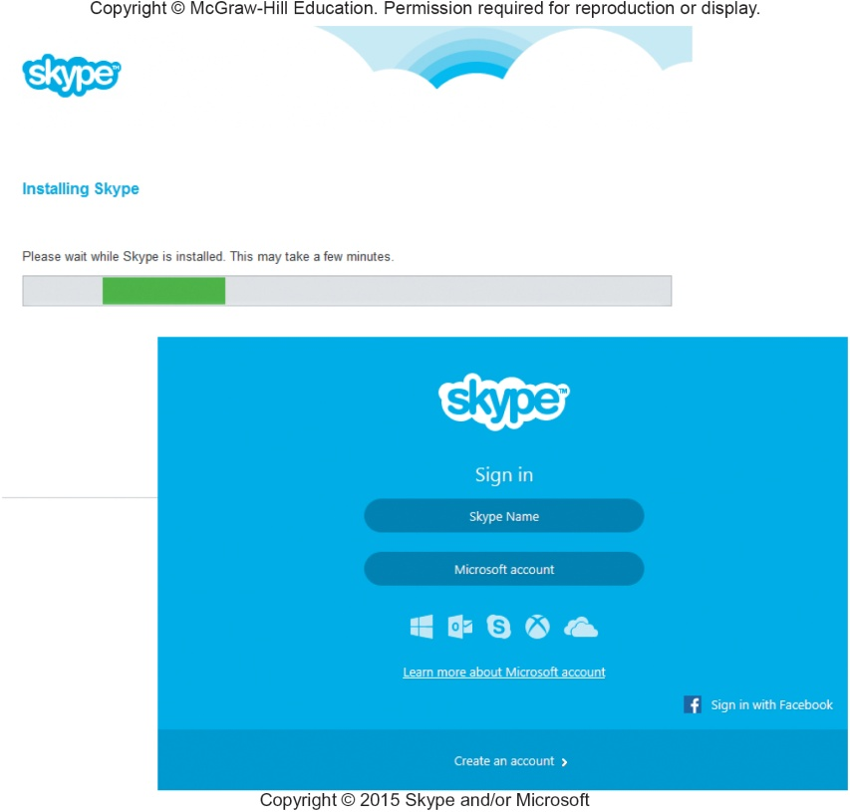
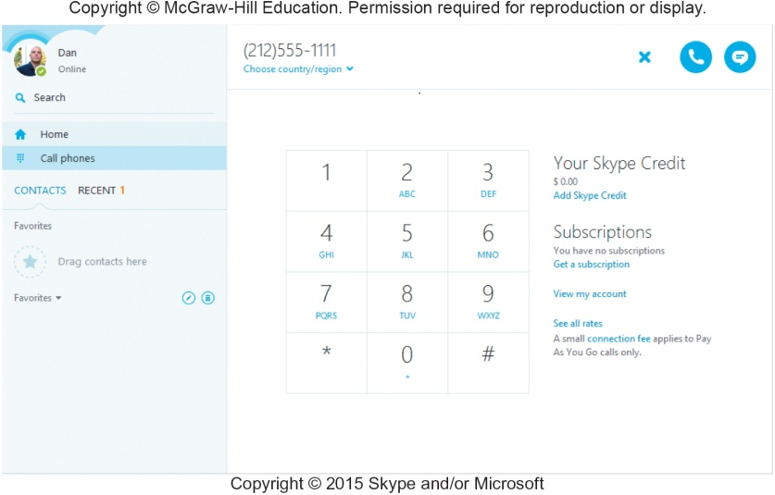
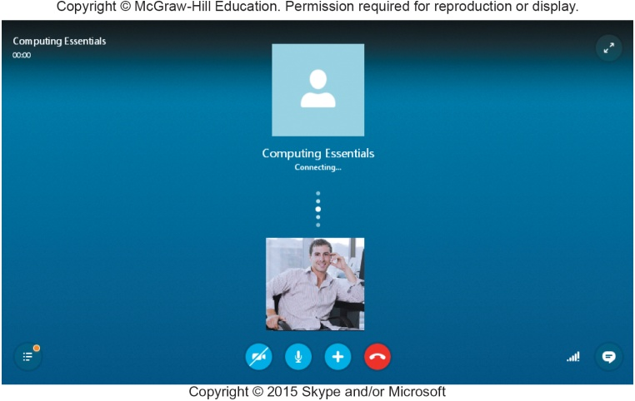
Making IT Work for You ~ Skype
Communications tool using VoIP
www.skype.com

Slide 31
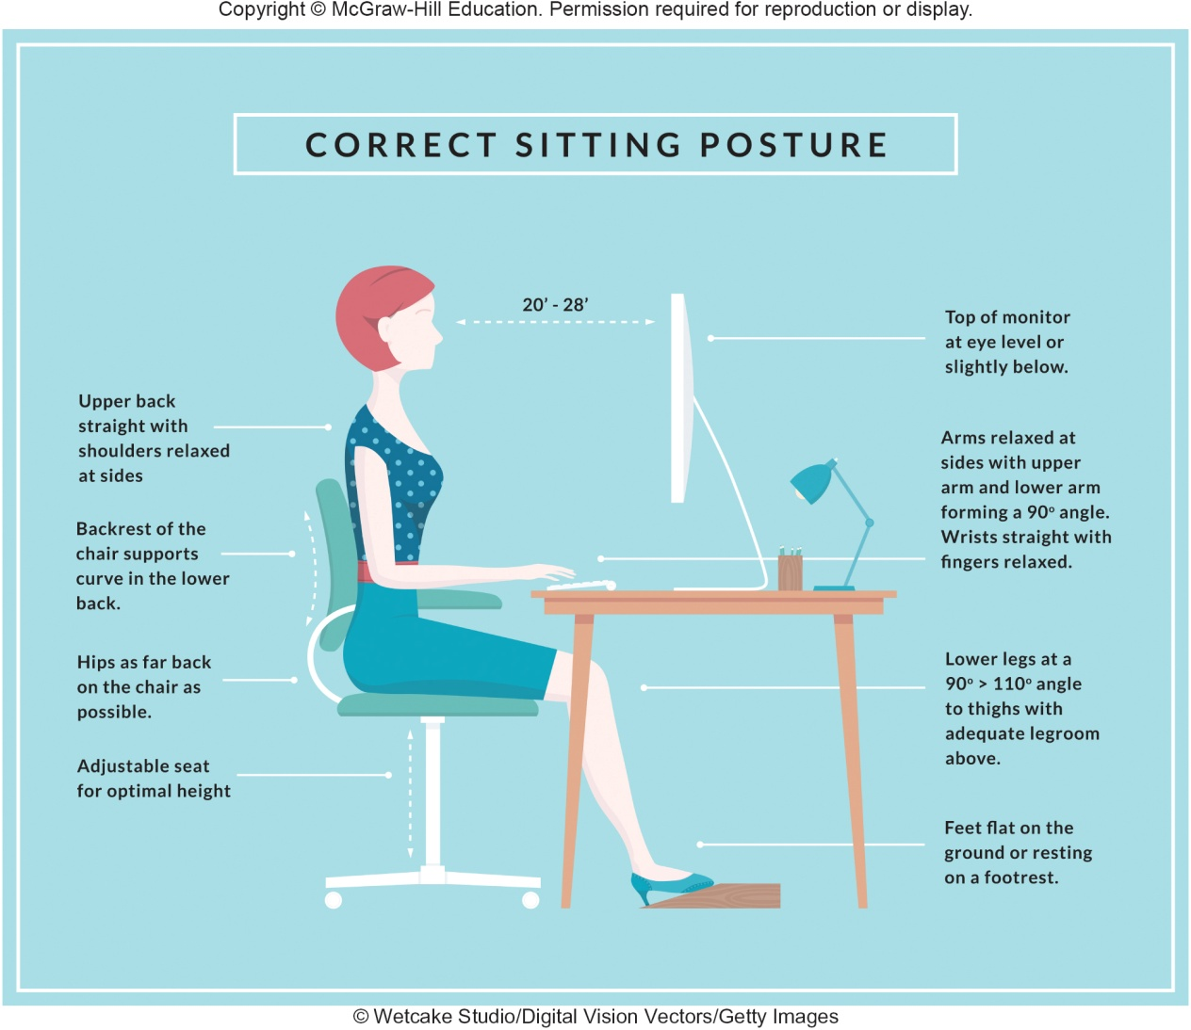
Ergonomics
Study of human factors related to things people use
Fit the task to the user to avoid:
Eyestrain and headache
Back and neck pain
Repetitive strain injury
Notes:
Ergonomics (key term) – fitting the task to the user
Study to avoid :
Eyestrain (key term) and headache (key term) – 15 minute break every hour
Back and neck pain (key term) – equipment should be adjustable
Repetitive strain injury (key term) RSI (key term) – injury caused by repetitive injury
Carpal tunnel syndrome (Key term) – damage to nerves and tendons in hands

Slide 32
Ergonomic Challenged Devices
Portable devices are not set up for ergonomics
Laptops
Because the keyboard and monitor are connected, they cannot be set up ergonomically
Tablets
Tablet hunch is caused by the users head being improperly aligned to the viewing surface
Smartphones
Blackberry thumb results from using thumbs to type on a tiny keyboard
Notes:
Portable devices are not set up for ergonomics
Study to avoid :
Laptops – raise the level of the screen with books or reams of paper or connect an external keyboard
Tablets – avoid tablet hunch by taking frequent breaks or using a stand or external keyboard
Smartphones – avoid blackberry thumb by keeping wrists straight, head up and shoulders straight.

Slide 33

Careers In IT
Technical writers prepare instruction manuals, technical reports, and other scientific or technical documents
Typically requires an associates or bachelors degree in:
Communications
Journalism or
English
Specialization or familiarization with a technical field
Technical writers can expect to earn $44,000 to $58,000 annually

Slide 34
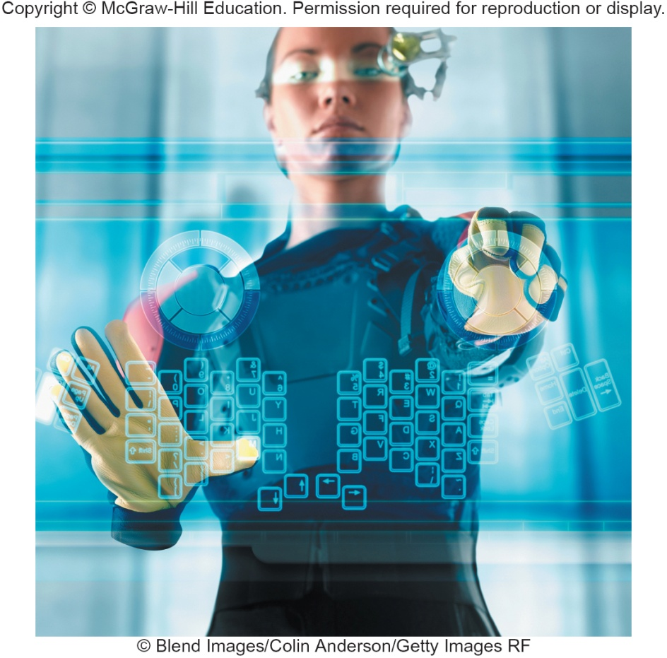
A Look to the Future Augmented Reality Displays
With wearable augmented reality displays, data from your computer and the Internet will be instantly viewable
Funding for development from the government has begun to assist soldiers and pilots.
Google has developed a prototype, “Project Glass”, that is being tested

Slide 35
Open-Ended Questions (Page 1 of 2)
Define input and input devices.
Describe the different types of keyboard, pointing, scanning, image capturing, and audio-input devices.
Describe output and output devices.
Describe the features and different types of monitors and printers.
Notes:
Have students turn to the end of Chapter 6 in their textbooks to view the same “Open-Ended” questions/statements

Slide 36
Open-Ended Questions (Page 2 of 2)
Describe audio output devices including Bluetooth technology.
Discuss combination input and output devices, including multifunctional devices, headsets, telephones, drones, robots, and virtual reality headgear and gloves.
Define ergonomics, describe ways to minimize physical discomfort, and discuss design issues with portable computers.
Notes:
Have students turn to the end of Chapter 6 in their textbooks to view the same “Open-Ended” questions/statements.

